Slide 1
Project 1 - Berlin - Football Scouting Agency
By: Jorge & Sherif

Slide 2
Project Overview
Our business case:
We are a data-driven football scouting agency that helps provide insights on the top football players for teams worldwide.
Current problem statement:
A football club tasked us with finding the top 5 most productive and cost-efficient players in the world currently.
Our Data:
We opted for an API from the famous football statistics website Transfermarkt, we used different endpoints to extract the data we need and create a dataset to showcase the information our client needs.
For additional insight we also compared our 2024 data with 2022, Which lead to these 2 hypotheses:
Hypothesis 1: None of the top 5 most productive players will have a market value lower than 50M EUR.
Hypothesis 2: Not a single player from the top 5 in 2022 will still be in the top 5 in 2024.
Notes:
Which topic did you choose and why?
Briefly describe the original dataset and the hypothesis you formulated.
Explain the structure and process of your data cleaning and analysis.
Highlight any unique data cleaning techniques or methods you’ve employed.

Slide 3
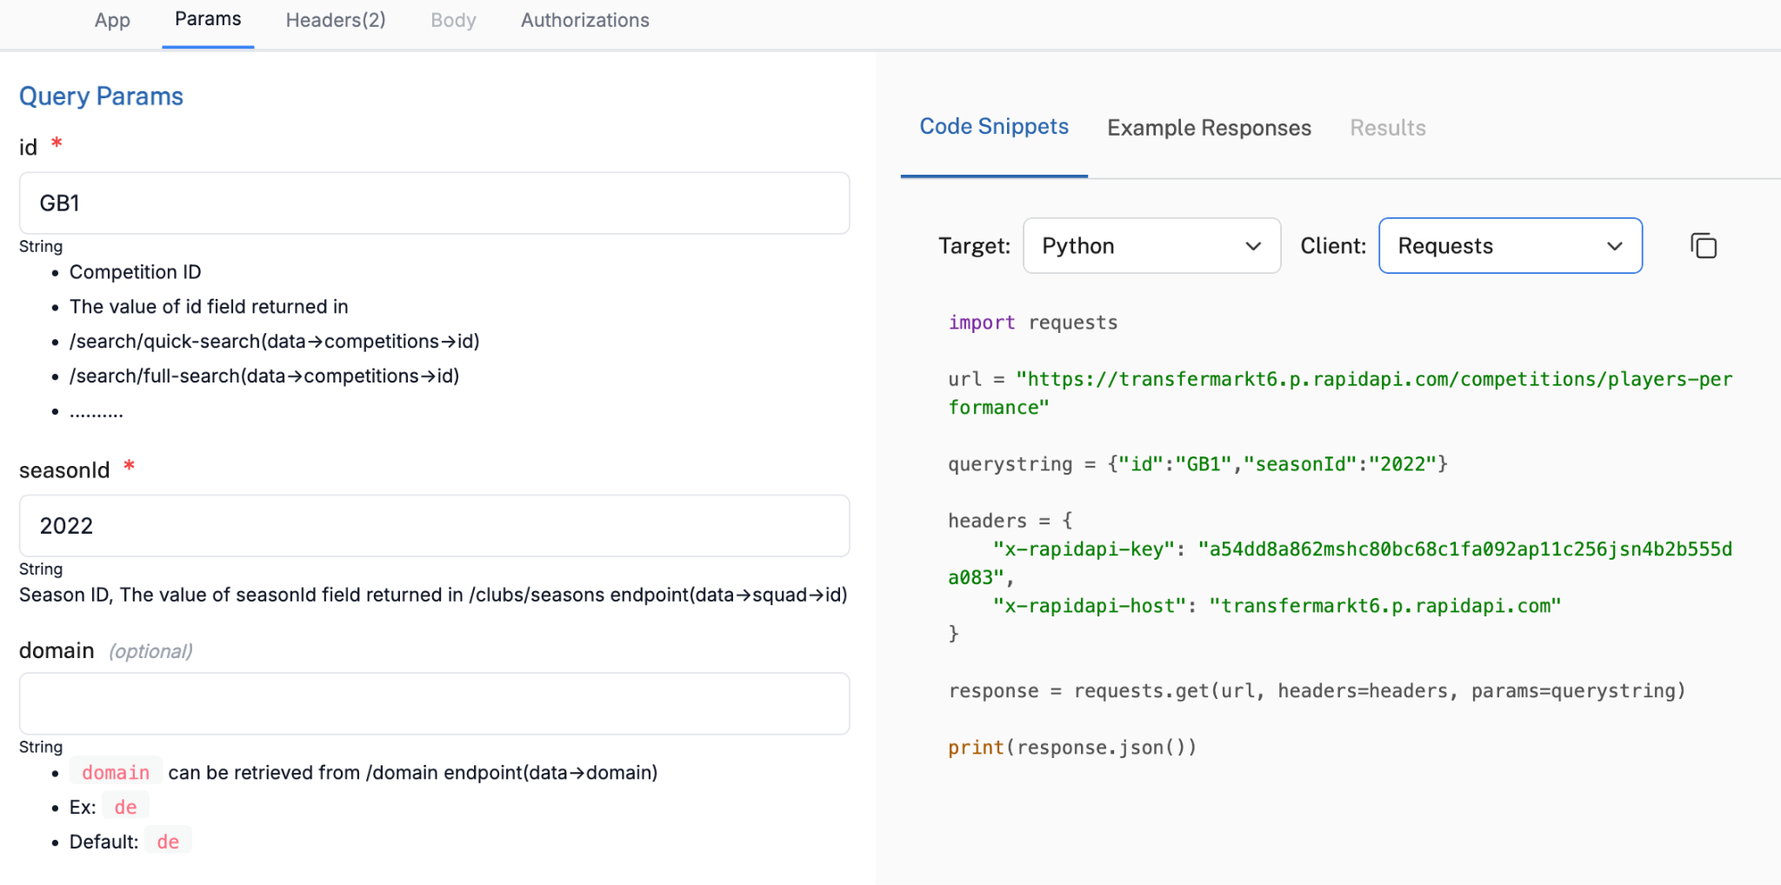
Data Collection
We had to explore multiple different endpoints from our API to understand what data we can access.
We ran different queries on RapidAPI in order to find where our desired data lies.
Then using the code we called the API and saved our data locally.
The challenge was that we only had a limited number of free API calls so we had to be precise!
Notes:
Explain how you used APIs and web scraping to collect and enrich your dataset.
API Endpoints
Running Queries to access specific data

Slide 4
Data Wrangling & Cleaning
Despite the long hassle with getting the API data saved, the dataset in the end was quite cleaned up, but we still had to do the following:
Standardising column names in lowercase & no spaces.
Merging the different datasets we gathered into 1 unified df.
Dropping columns we didn’t think added value to our business case.
Introducing a “Goal Contribution Efficiency” column to our merged dataframe.
Dropping rows that had a null value for our new column (0 goals & 0 assists).
We also got the idea to save our cleaned dataframe as a CSV, in order to save us the time of working on our code without having to repeat multiple steps again, which was helpful!
Notes:
Discuss the significant data cleaning challenges you encountered (missing data, duplicates, formatting issues, etc.).
Explain how you resolved these challenges.

Slide 5
EDA Methods
For our EDA we had to apply quite a few different methods:
Calculating goal contribution efficiency by dividing the minutes played by the sum of the goals + assists, and displaying it a new column.
Filtering out players who have played minutes below the mean, to exclude some outliers.
Sorting our df from lowest to highest (lowest being the most efficient players)
Filtering our df to check for players worth less than 50M EUR for Hypothesis 1.
Added in column to measuring how cost-effective each player using their market value.
For further insights:
Calculated the mean of our goal contribution & market value to compare it with 2022 dataset
Calculated the % change for goal contribution & market value from 2022 to 2024.
Notes:
Discuss the exploratory data analysis methods you used.
Share insights and interesting patterns you found.
Plotting the charts

Slide 6
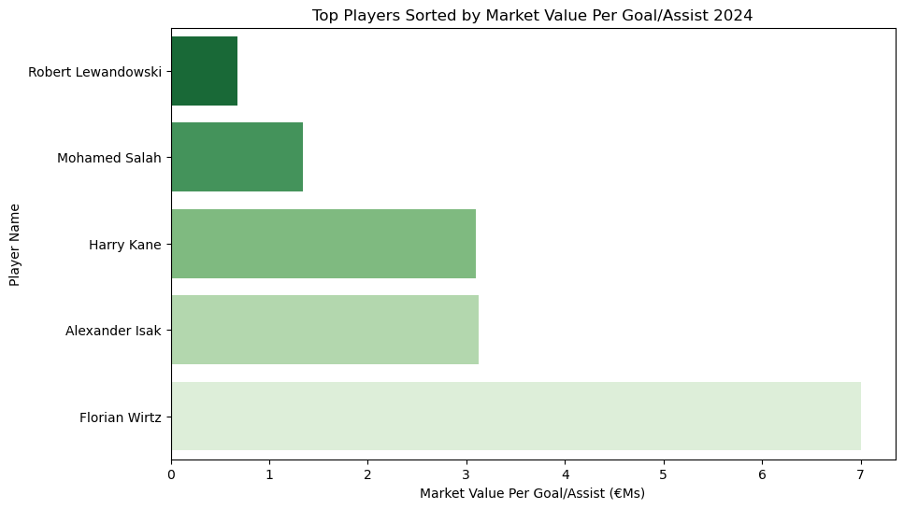
Problem Statement Chart

Slide 7
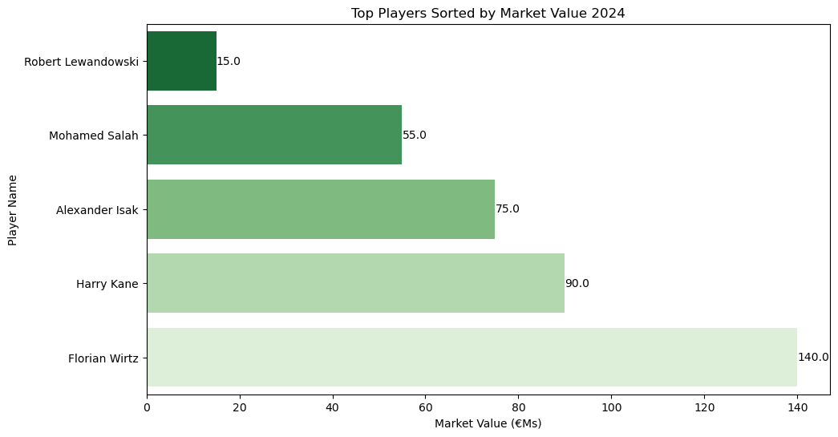
Hypothesis Conclusion
Hypothesis 1: None of the top 5 most productive players will have a market value lower than 50M EUR.
Disproved!
As we can see from the table below there was in face a player in the top 5 ‘Robert Lewandowski’ who has a market value of 15M EUR, which is great value for his contributions!
Notes:
Discuss whether your initial hypothesis was supported or refuted.
Share main learnings and any surprising insights or findings.
Discuss potential implications of your findings.
Where there any questions you couldn’t answer?

Slide 8
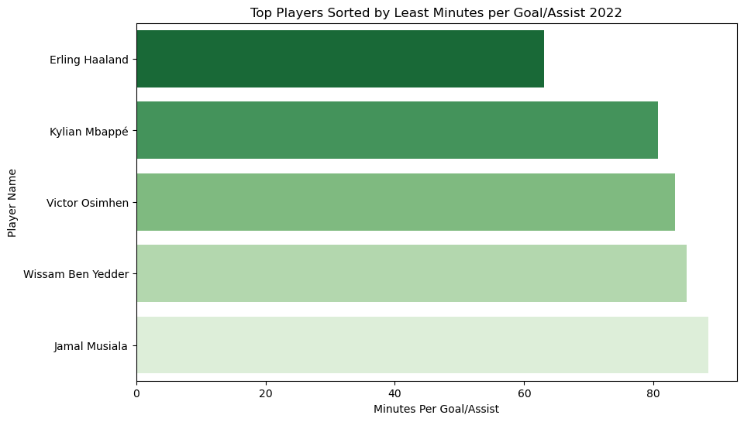
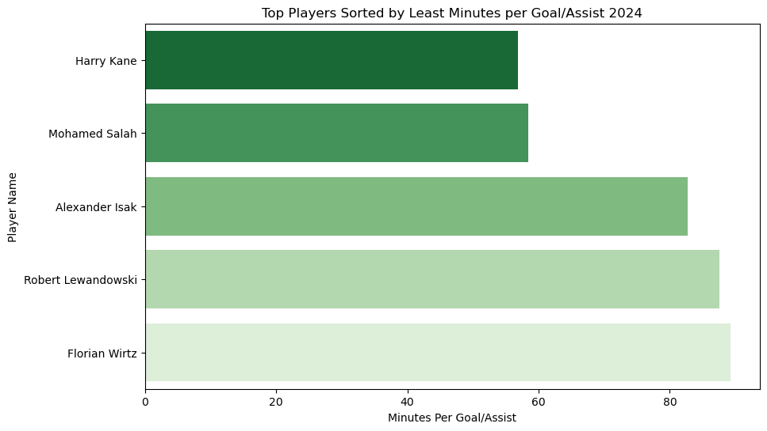
Hypothesis Conclusion
Hypothesis 2: Not a single player from the top 5 in 2022 will still be in the top 5 in 2024.
Proved!
As we can see from the two charts of 2022 & 2024, there were no players who were part of the top 5 in 2022 that also made the top 5 2 years later, showcasing it is quite difficult to stay consistently one of the best!
Notes:
Discuss whether your initial hypothesis was supported or refuted.
Share main learnings and any surprising insights or findings.
Discuss potential implications of your findings.
Where there any questions you couldn’t answer?

Slide 9
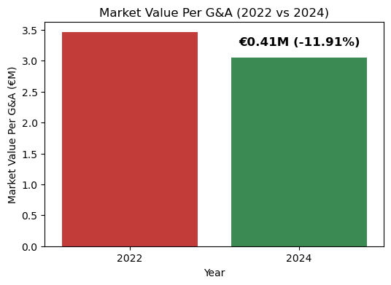
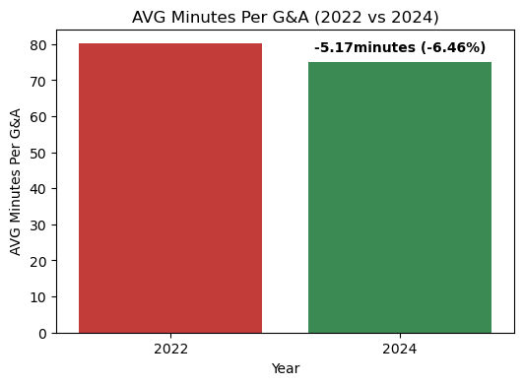
Further Insights
When comparing 2022 and 2024, we observed that the top 5 contributing players in 2024 have become more efficient per minute while also having a lower average market value.
Notes:
Discuss whether your initial hypothesis was supported or refuted.
Share main learnings and any surprising insights or findings.
Discuss potential implications of your findings.
Where there any questions you couldn’t answer?

Slide 10
Major Obstacles
Key Challenges Faced
How we overcame them
1- Testing multiple endpoints on RapidAPI and examining what is in the dataset before we try to import it into our code.
2- Saved our dfs locally as CSV or JSON whenever we completed a major milestone, so we can instantly access it again.
3- Filtering out our df to first show us the top 5 players then only calling those 5 player ids, rather than using thousands of API calls that we did not have.
1- Finding the right API endpoints to access the data we needed.
2- Having to run multiple lines of code again every time we open our notebook file
3- Calling on the API again to match our thousands of player ids to with more data from other endpoints & merge them with our dataframe.

Slide 11
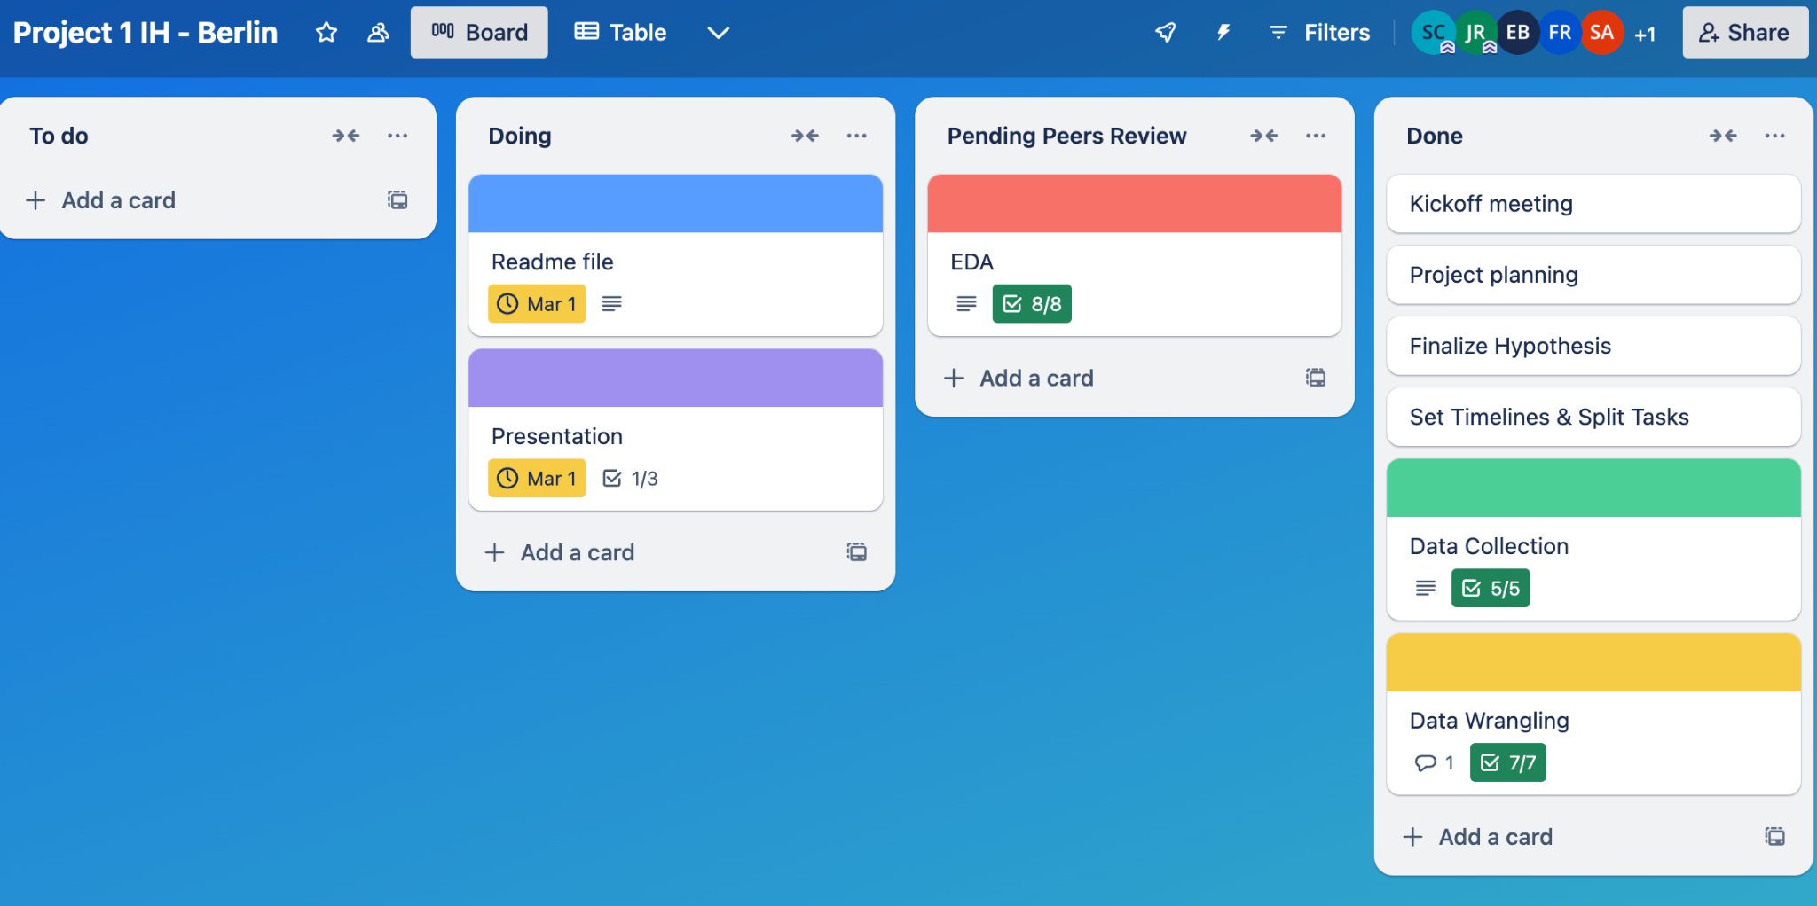
Teamwork & Project Management
We enjoyed using the Trello board as it visualised our project’s progress easily.
We split it up into categories of tasks such as data collection, wrangling, EDA etc… then added in sub-tasks for those categories and split them up.
Things went smoothly for splitting up the tasks and we agreed on deadlines to have that task in the “Pending Peers Review” column so we can look at it together in class and add it to our main file.
Notes:
Did you follow your workflow plan or did you add something after starting the project?
What worked well in your teamwork and what could be improved?
Did you think about the risk management?

Slide 12
From: Jorge & Sherif

